Slide 1
COMP9501 · Advanced Machine Learning
Visual Recognition in RGB Images and Videos
by Learning from RGB-D Data
Domain adaptation from multi-view to single-view (DAM2S)
Presented by Group 21
W. Li*, L. Chen*, D. Xu and L. Van Gool
IEEE TPAMI, 40(8), 2030–2036, August 2018
Notes:
MAIN TALK — SLIDE 1
Suggested duration: 30 seconds
SPOKEN SCRIPT
Hello, I am XX. Today I present DAM2S: domain adaptation from multi-view to single-view. The question is whether depth information available during training can improve an RGB-only recognizer in a different domain. We will introduce the problem and related work, explain the formulation and optimization, compare the published results across three tasks, then examine our object-recognition reproduction. Our focus is how margin-based learning, domain alignment and training-only information interact.
PRESENTER CUE — NOT SPOKEN
Introduce the paper, then make eye contact. Pronounce DAM2S as 'D-A-M-two-S'. Do not read the full bibliographic line.
SHORT VERSION — USE ONLY IF RUNNING LATE
DAM2S learns an RGB-only recognizer from RGB-D training data in another domain. We examine its mathematics and our partial reproduction.
Source: Li et al., IEEE TPAMI 40(8), 2030–2036, 2018. DOI: https://doi.org/10.1109/TPAMI.2017.2734890

Slide 2
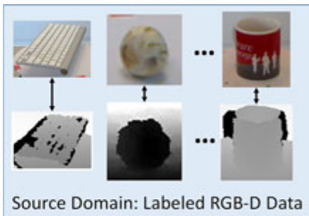
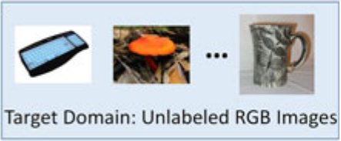


Depth Helps, But Is Missing at Test Time
Background
TRAIN
RGB-D data · labeled
TEST
RGB only · unlabeled
?
Phones & everyday cameras
RGB-D Object · Hollywood 3D · ACT4²
No depth sensor · no depth map
Can labeled RGB-D data help us recognize RGB-only images and videos?
Notes:
MAIN TALK — SLIDE 2
Suggested duration: 60 seconds
SPOKEN SCRIPT
Hello everyone. I will cover the background, related work and research objectives of this paper. First, the background. RGB-D cameras such as the Kinect are now widespread, and several labeled RGB-D datasets have been released, for example RGB-D Object, Hollywood 3D and ACT4². Depth is more robust to illumination changes and cluttered backgrounds, so it complements RGB, and it has already been shown to help object and action recognition. But here is the catch: most images and videos we meet in practice come from phones or ordinary cameras. They only have RGB, with no depth. In other words, depth is available at training time but not at test time. So the question this paper asks is: can we use existing labeled RGB-D data to recognize RGB-only images and videos?

Slide 3
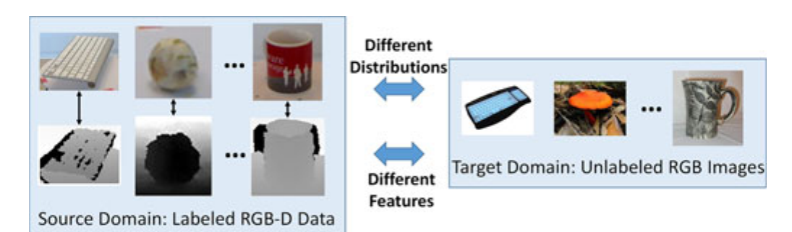
Two Core Challenges
Background
New Unsupervised DA Problem
Source labeled · RGB + depth
Target unlabeled · RGB only
Fig. 1 of the paper
1
Different Features
2
Different Distributions
Source: RGB + depth. Target: RGB only.
How can depth help without being needed at test time?
Devices and scenes differ: dataset bias
Direct transfer hurts accuracy badly.
Notes:
MAIN TALK — SLIDE 3
Suggested duration: 90 seconds
SPOKEN SCRIPT
There are two core challenges, and they are drawn in Fig. 1 of the paper: the source domain on the left, the target domain on the right, and two arrows in the middle, one for each challenge. The first is feature asymmetry. The source domain has RGB and depth, but the target domain has RGB only. So how can we use depth in training, while not needing it at test time? The second is distribution mismatch, also known as dataset bias. Training and test data are captured with different devices in different scenes. For example, RGB-D Object contains clean objects photographed on a turntable, while Caltech-256 contains natural web images. Their distributions are very different, and transferring a model directly makes accuracy drop sharply. The authors therefore formulate this as a new unsupervised domain adaptation problem: the source domain is labeled and has both visual and depth features; the target domain is unlabeled and has visual features only. Both challenges matter, so both must be solved together. Can existing work do that? Let us look at the related work.

Slide 4



Existing Methods Solve Only Half
Related Work & Research Gap
Method family
Examples
① Uses depth
② Handles shift
Main limitation
Unsupervised DA
KMM · TCA · SA · DIP
Same features assumed; depth unused
Multi-view learning
KCCA · SVM-2K
Needs multiple views at test time
Privileged info (LUPI)
SVM+
Assumes train/test share one distribution
The open question
?
Solve both challenges
Also: heterogeneous DA needs target labels; multi-view DA needs all views in the target domain. Neither fits our setting.
Notes:
MAIN TALK — SLIDE 4
Suggested duration: 120 seconds
SPOKEN SCRIPT
(Tip: animate the rows so that the last row appears last.) Let's go through three families of related work, row by row. First, unsupervised domain adaptation, such as KMM, TCA, SA and DIP. These methods reduce the distribution gap, so they address Challenge 2. But they assume both domains share the same features, so the depth available only in the source domain is never used. Second, multi-view learning, such as KCCA and SVM-2K. They can use multiple feature types, but they assume multiple views are also available at test time, and they do not handle distribution shift. Third, learning using privileged information, such as SVM+. Its extra features are used only in training, which is closest to our setting, but it assumes training and test data come from the same distribution. In addition, heterogeneous domain adaptation needs labeled target samples, and multi-view domain adaptation needs all views in the target domain; neither fits our setting, as noted in the footer. So each family solves only half of the problem. Is there a method that solves both challenges together? Not in existing work, and that is exactly the gap this paper fills.

Slide 5



DAM2S: One Framework, Both Challenges
Research Objectives
DAM2S Domain Adaptation from Multi-view to Single-view
min
SVM classifiers
+
μ · Ω(P)
+
λ · Δ(·,·)
complexity + loss
Domain gap → Challenge 2
Depth → Challenge 1
2 × 2 strategies → 3 algorithms
CVPR'14 = DAM2S_A
Three Evaluation Tasks
Δ: correlation
Δ: consistency
Object recognition
Ω: MMD
DAM2S_A
DAM2S_B
Cross-dataset actions
Ω: Kernel SA
—
DAM2S_C
Cross-view actions
Notes:
MAIN TALK — SLIDE 5
Suggested duration: 120 seconds
SPOKEN SCRIPT
To fill this gap, the objective of the paper is a unified framework called DAM2S, which stands for Domain Adaptation from Multi-view to Single-view. It should reduce the domain distribution gap and exploit the source-domain depth features at the same time. This has three parts. First, one unified objective: on top of the SVM classifiers we add two regularizers. Omega reduces the distribution gap and corresponds to Challenge 2. Delta links the visual and depth features and corresponds to Challenge 1. Second, the framework is modular. Omega can be MMD or Kernel SA; Delta can maximize feature correlation or enforce classifier consistency. Together they yield three algorithms, DAM2S_A, B and C, and the authors' CVPR 2014 method is simply A. Third, validation on several tasks: object recognition, cross-dataset action recognition and cross-view action recognition, covering both images and videos. Let us now look at the training objective and see precisely how Omega and Delta enter it.

Slide 6
Method
DAM2S as Regularized Empirical Risk Minimization
Term | Machine-learning role
r | Control classifier complexity
ℓ | Fit source labels with a margin
Ω | Reduce the RGB domain mismatch
Δ | Transfer information from paired depth
Li et al., Eq. (1). Binary one-vs-rest labels are used for each class.
06
Notes:
MAIN TALK — SLIDE 6
Suggested duration: 55 seconds
SPOKEN SCRIPT
Here, x denotes an RGB feature, z a depth feature, and y a source label. We use one classifier per class, so l sub i k is plus one for class k and minus one otherwise. Theta collects the trainable parameters.
The objective has four terms. The first controls classifier complexity. The second fits the source labels. Omega reduces the RGB domain mismatch using source and unlabeled target data. Delta couples RGB and depth using paired source examples. C, mu and lambda determine their relative importance.
This is regularized empirical risk minimization with two additional inductive biases: transferable geometry and cross-view agreement. We will unpack the supervised component first.
PRESENTER CUE — NOT SPOKEN
Trace the four terms from left to right, then use the table as a verbal summary. Spend more time on what each term does than on naming every symbol.
FORMULA READING GUIDE — REHEARSAL REFERENCE
Say 'f superscript v' for the RGB model and 'f superscript d' for the depth model. Say 'mu times Omega of P' and 'lambda times Delta'. Theta means all trainable parameters, subject to the chosen variant's constraints.
SHORT VERSION — USE ONLY IF RUNNING LATE
The objective combines complexity control, source classification, domain alignment and depth transfer. The tradeoff parameters decide how strongly each requirement influences learning.
Sources: https://wenli-vision.github.io/papers/Li_TPAMI2017_RGBD.pdf
Equation source (LaTeX, for future editing):
\[ \mathcal{D}_s=\{(x_i^s,z_i,y_i)\}_{i=1}^{n_s},\qquad\mathcal{D}_t=\{x_j^t\}_{j=1}^{n_t},\qquad l_{ik}\in\{-1,+1\} \]
\[ \min_{\Theta}\;\left\{r(f^v,f^d)+C\,\ell(f^v,f^d)+\mu\,\Omega(P)+\lambda\,\Delta\right\} \]

Slide 7
Method
Two SVMs for Supervised Learning
Large margin
Penalize small or incorrect margins while controlling weight norms.
Kernel representation
φ and ψ allow nonlinear RGB and depth models through Gram matrices.
Li et al., Eqs. (7)–(13). The displayed RGB score applies to A/B.
07
Notes:
MAIN TALK — SLIDE 7
Suggested duration: 50 seconds
SPOKEN SCRIPT
For A and B, the RGB classifier first maps x through the kernel feature map phi, then projects it with P transpose. A linear SVM produces the class score.
The regularizer penalizes the squared weight norms of both classifier heads. The loss sums two hinge penalties over source examples and classes, one for RGB and one for depth. If the signed score is at least one, its hinge loss is zero. Otherwise, the penalty encourages a larger correct margin.
The kernel representation permits nonlinear models through inner products, without explicitly constructing every feature-space coordinate. So the familiar SVM machinery supplies source discrimination. The next term asks whether that representation also transfers across domains.
PRESENTER CUE — NOT SPOKEN
Point to the score, then the norm penalty, then the two hinge terms. Briefly pause at 'at least one'. Keep the distinction between source discrimination and target performance clear.
FORMULA READING GUIDE — REHEARSAL REFERENCE
Read the first line as 'f v k of x equals w k transpose P transpose phi of x, plus b k'. Read [a]+ as 'the positive part of a'. The tilde marks the depth-head weights.
SHORT VERSION — USE ONLY IF RUNNING LATE
Each view has an SVM. Weight penalties control capacity, while hinge losses encourage correct source margins. Kernels make the representation nonlinear.
Sources: https://wenli-vision.github.io/papers/Li_TPAMI2017_RGBD.pdf
Equation source (LaTeX, for future editing):
\[ f_k^v(x)=w_k^{\top}P^{\top}\phi(x)+b_k \]
\[ r=\frac{1}{2}\sum_{k=1}^{K}\left(\Vert w_k\Vert_2^2+\Vert\widetilde{w}_k\Vert_2^2\right) \]
\[ \ell=\sum_{i=1}^{n_s}\;\sum_{k=1}^{K}\left([1-l_{ik}f_k^v(x_i^s)]_+ + [1-l_{ik}f_k^d(z_i)]_+\right) \]
\[ [a]_+=\max(0,a) \]

Slide 8
Method
Maximum Mean Discrepancy (MMD)
Why normalization matters
P = 0 erases the mean difference.
Variant B prevents collapse with
What MMD can miss
Equal projected means do not guarantee class-conditional alignment or high target accuracy.
Li et al., Eq. (2). Trace form and gradient below are algebraic derivations.
08
Notes:
MAIN TALK — SLIDE 8
Suggested duration: 65 seconds
SPOKEN SCRIPT
Delta, the lowercase symbol here, is the difference between the mean source and target kernel features. After projection, the mismatch becomes P transpose delta. The MMD penalty is half its squared norm.
Using the identity that a squared norm can be written as a trace gives the second expression. Differentiating with respect to P gives delta times delta transpose times P. This makes the alignment term a simple quadratic in the projection.
But alignment alone admits a useless solution: P equals zero. B prevents that collapse by fixing the projected source scatter to the identity.
There is also a statistical limit. Equal projected means do not imply that corresponding classes align, or that target accuracy improves. The classifier loss must preserve useful information while the alignment term encourages transfer.
PRESENTER CUE — NOT SPOKEN
Point to the domain means, then the squared norm, then the gradient. Pause before the P equals zero example. Lowercase delta is a vector; uppercase Delta in the objective on slide 6 is the depth-transfer penalty.
FORMULA READING GUIDE — REHEARSAL REFERENCE
Say 'Omega sub MMD of P'. Read the gradient as 'the gradient with respect to P equals delta delta transpose P'. Phi sub s stacks source RGB feature vectors as columns; I sub m is the m-dimensional identity.
SHORT VERSION — USE ONLY IF RUNNING LATE
MMD matches projected domain means. A normalization constraint prevents a zero projection, but matching means alone cannot guarantee class alignment or target accuracy.
Sources: https://wenli-vision.github.io/papers/Li_TPAMI2017_RGBD.pdf
Equation source (LaTeX, for future editing):
\[ \delta=\frac{1}{n_s}\sum_{i=1}^{n_s}\phi(x_i^s)-\frac{1}{n_t}\sum_{j=1}^{n_t}\phi(x_j^t) \]
\[ \Omega_{\mathrm{MMD}}(P)=\frac{1}{2}\Vert P^{\top}\delta\Vert_2^2=\frac{1}{2}\operatorname{tr}(P^{\top}\delta\delta^{\top}P) \]
\[ \nabla_P\Omega_{\mathrm{MMD}}(P)=\delta\delta^{\top}P \]
\[ P^{\top}\Phi_s\Phi_s^{\top}P=I_m \]

Slide 9
Method
How Depth Guides RGB Learning
A: maximize paired feature correlation
Projected RGB and depth features share an m-dimensional space.
B / C: penalize disagreement between source scores
ε = 0.001 allows a small tolerance. Depth guides the model during training.
Large λ can force harmful agreement when the views disagree.
Li et al., Eqs. (6) and (10). The agreement loss is written up to a constant.
09
Notes:
MAIN TALK — SLIDE 9
Suggested duration: 60 seconds
SPOKEN SCRIPT
The depth term can guide either representations or predictions. A learns RGB and depth projections into a shared space. It maximizes the correlation of paired features. The negative sign makes this correlation objective compatible with minimization.
B and C instead encourage the two classifier heads to give similar scores on each source example. The absolute score difference is penalized only when it exceeds epsilon, which is set to zero point zero zero one. This is an epsilon-insensitive agreement loss. Our displayed form differs from the paper's form only by a constant, so its minimizers are unchanged.
Depth influences training without becoming a required test input. However, a large lambda can force harmful agreement. Its value determines how strongly we trust the extra modality.
PRESENTER CUE — NOT SPOKEN
Use the upper half for representation agreement and the lower half for prediction agreement. Do not call the depth classifier a fixed teacher. Both heads are learned.
FORMULA READING GUIDE — REHEARSAL REFERENCE
Say 'minus the trace of Q transpose Psi Phi s transpose P'. In the lower line, explain the absolute disagreement minus epsilon, followed by the positive part. The constant difference in the full objective is lambda times K times n s times epsilon.
SHORT VERSION — USE ONLY IF RUNNING LATE
A transfers depth through feature correlation. B and C use classifier-score agreement. Excessive agreement can hurt when depth gives an unhelpful training signal.
Sources: https://wenli-vision.github.io/papers/Li_TPAMI2017_RGBD.pdf
Equation source (LaTeX, for future editing):
\[ \Delta_{\mathrm{corr}}(P,Q)=-\operatorname{tr}(Q^{\top}\Psi\Phi_s^{\top}P) \]
\[ \Delta_{\mathrm{agree}}=\sum_{i=1}^{n_s}\;\sum_{k=1}^{K}\left[\left|f_k^v(x_i^s)-f_k^d(z_i)\right|-\epsilon\right]_+ \]

Slide 10
Method
Three Variants, Two Design Choices
Variant | Domain term Ω | Depth term Δ
A | Projected MMD | Feature correlation
B | Projected MMD | Score agreement
C | Kernel subspace alignment | Score agreement
C learns an m × m transform near the kernel alignment T.
Li et al., Table 1 and Eqs. (4)–(5). P has a different meaning in C.
10
Notes:
MAIN TALK — SLIDE 10
Suggested duration: 60 seconds
SPOKEN SCRIPT
This table separates the two design choices. A and B use projected MMD for domain alignment. A uses feature correlation for depth transfer, whereas B uses score agreement. C retains score agreement but changes the domain term.
For C, kernel PCA produces source and target subspace bases. Their cross-product gives the geometric alignment matrix T. The model then learns a discriminative transformation P, penalized for moving too far from T.
One notation detail matters: P is an m-by-m transformation in C. In A and B, it projects RGB kernel features into an m-dimensional space. These are different objects. The resulting prediction rules differ too; the detailed formulas are in the backup slides. All three variants still couple representation learning with classification.
PRESENTER CUE — NOT SPOKEN
Compare A with B vertically, then B with C. Point to the Frobenius penalty when introducing P and T. Do not imply that all three variants apply the same transform to target inputs.
FORMULA READING GUIDE — REHEARSAL REFERENCE
Say 'S s equals Phi s A tilde s'. The tilde-A matrices contain kernel-PCA coefficients. Read the norm as 'the squared Frobenius norm of P minus T'.
SHORT VERSION — USE ONLY IF RUNNING LATE
A and B differ in depth transfer; B and C differ in domain alignment. C learns a transform near a kernel-PCA subspace alignment.
Sources: https://wenli-vision.github.io/papers/Li_TPAMI2017_RGBD.pdf
Equation source (LaTeX, for future editing):
\[ S_s=\Phi_s\widetilde{A}_s,\qquad S_t=\Phi_t\widetilde{A}_t,\qquad T=S_s^{\top}S_t \]
\[ \Omega_{\mathrm{KSA}}(P)=\frac{1}{2}\Vert P-T\Vert_F^2 \]
Notation refinement: tilde A_s and tilde A_t are the kernel-PCA coefficient matrices, distinct from the all-sample expansion coefficients A on slide 23.

Slide 11
Method
Alternating Optimization of Projections and SVMs
1
Fix the representation
Optimize the SVM variables. B/C couple the two views through score agreement.
2
Fix the SVM dual variables
Update the projection or subspace transform, then repeat.
Bilinear scores make joint training nonconvex.
Reported stopping iterations: A 9, B 8, C 3. Descent does not prove global optimality.
Li et al., §3.4. Iteration counts below are reported in the reproduction handoff.
11
Notes:
MAIN TALK — SLIDE 11
Suggested duration: 50 seconds
SPOKEN SCRIPT
The representation and the classifiers depend on each other, so the method alternates between them. With the representation fixed, it solves the SVM problem. With the SVM dual variables fixed, it proposes an update to the projection or transformation.
The joint problem is nonconvex because scores contain products of classifier and projection parameters. In our implementation, candidate updates are evaluated after re-solving the classifiers, and only improving candidates are accepted.
The handoff reports nine, eight and three stopping iterations for A, B and C. Objective descent is useful evidence of numerical progress, but it does not prove global optimality or monotonically improving target accuracy. Let us compare the three transfer tasks in Table 2 of the paper before looking at the task we reproduced.
PRESENTER CUE — NOT SPOKEN
Gesture between the two steps. Emphasize 'dual variables', not fixed primal classifier weights. Report the iteration counts as documented results, without claiming a new convergence experiment.
SHORT VERSION — USE ONLY IF RUNNING LATE
Alternation makes training manageable, but the joint problem remains nonconvex. A decreasing objective does not establish a globally optimal or better-generalizing model.
Sources: https://wenli-vision.github.io/papers/Li_TPAMI2017_RGBD.pdf; /Users/weidai/Desktop/COMP9501/DAM2S论文复现_转交文档.pdf pp. 3–5

Slide 12
Paper Experiments
Recognition Accuracy Across Three Tasks
Mean per-class accuracy (%)
Recognition task | Best baseline | DAM2S_A | DAM2S_B | DAM2S_C
Object recognition RGB-D Object → Caltech-256 | 45.13 (DIP) | 53.17 | 54.33 | 56.89
Cross-dataset action Hollywood 3D → Hollywood2 | 29.56 (SA) | 30.64 | 31.75 | 39.17
Cross-view action ACT4², views 1–2 → views 3–4 | 65.36 (SVM+) | 68.86 | 68.85 | 65.56
C leads on both cross-dataset tasks. A and B differ by 0.01 points across views.
Source: Li et al., Table 2 and §4.2.
12
Notes:
MAIN TALK — SLIDE 12
Suggested duration: 60 seconds
SPOKEN SCRIPT
The paper reports mean per-class target accuracy on three transfers. The first row is object recognition from RGB-D Object to Caltech-256. C scores 56.89%, compared with 45.13% for DIP, the strongest baseline.
The second row tests action recognition across two movie datasets, Hollywood 3D and Hollywood2. C leads again at 39.17%, ahead of SA at 29.56%. The third row uses one dataset, ACT4², with the first two camera views for training and the remaining two as the target. A reaches 68.86%, B reaches 68.85%, and SVM+ is the strongest baseline at 65.36%.
The highest-scoring variant therefore depends on the transfer setting. A and B differ by just 0.01 percentage points on the cross-view task. Our team reproduced the object-recognition row. We will compare that row directly before examining how much training-time depth contributed.
PRESENTER CUE — NOT SPOKEN
Read across one row at a time. DIP, SA and SVM+ are the strongest non-DAM2S comparators on their respective tasks. The ordering in Table 2 describes reported point estimates.
SHORT VERSION — USE ONLY IF RUNNING LATE
C leads on objects and cross-dataset actions. A and B are nearly tied on cross-view actions. Our reproduction covers the object task.
Source: Li et al., IEEE TPAMI, 2018, §4.2 and Table 2. https://wenli-vision.github.io/papers/Li_TPAMI2017_RGBD.pdf

Slide 13
Experiments
Reproducing the Object Recognition Experiment
Comparison | Original paper | Our reproduction
Task | RGB-D Object to Caltech-256 | Same transfer, 10 shared classes
RGB features | Caffe DeCAF6 (4,096-D) | AlexNet fc6 + ReLU (4,096-D)
Depth features | Gradient and LBP kernel descriptors | Reimplemented kernel descriptors
Source images | 2,059 training images | Uniform sampling of 2,059 images
Hyperparameters | Empirically chosen μ and λ per variant | Grid search using target labels
Both studies compare 14 methods using mean per-class accuracy.
Our run uses 1,132 target images. Their RGB features guide adaptation and their labels guide tuning.
Li et al., §4.2 and Table 2. Reproduction handoff, pp. 1, 4–7.
13
Notes:
MAIN TALK — SLIDE 13
Suggested duration: 50 seconds
SPOKEN SCRIPT
Our reproduction covers the object-recognition row of Table 2, from RGB-D Object to Caltech-256. We use the same ten shared classes, mean per-class target accuracy and fourteen methods: eleven baselines and three DAM2S variants. Our inputs contain 2,059 labeled source images and 1,132 target images.
The original paper uses Caffe DeCAF6 RGB features, while we use Torchvision AlexNet fc6 with ReLU. The paper reports 2,059 source training images. We match that count through uniform sampling. The authors set the regularization weights empirically, while our grid search selects hyperparameters using target labels.
The adaptation objective uses unlabeled target data, but selection uses target labels. The reported maxima are therefore target-oracle results. The next slide compares these object-recognition results with the original row.
PRESENTER CUE — NOT SPOKEN
The reproduced RGB feature is 4,096-dimensional, and depth uses reimplemented 28,000-dimensional kernel descriptors. The two action tasks were outside our reproduction scope. The paper reports empirical settings for mu and lambda. Its reporting does not establish that it used our target-label selection procedure.
SHORT VERSION — USE ONLY IF RUNNING LATE
The task, sample count, metric and method set match. We use uniform source sampling, different RGB features and target labels for model selection.
Sources: Li et al., §4.2 and Table 2. https://wenli-vision.github.io/papers/Li_TPAMI2017_RGBD.pdf; /Users/weidai/Desktop/COMP9501/DAM2S论文复现_转交文档.pdf, pp. 1, 5–7; supplied code/run_or.py and code/make_figures.py.

Slide 14
Experiments
Object Recognition: How Close Was Our Result?
Mean per-class accuracy (%) for five selected methods
C over DIP
+11.8 pp
Paper
+0.3 pp
Reproduction
Variant C ranked first in both studies. Its lead over DIP fell from 11.8 to 0.3 points.
Metric: mean per-class accuracy (%). Paper: Table 2. Reproduction: handoff, pp. 4–5.
14
Notes:
MAIN TALK — SLIDE 14
Suggested duration: 65 seconds
SPOKEN SCRIPT
The paper and our reproduction are shown side by side. The original figures come from the object-recognition row of Table 2. Among the DAM2S variants, the order remains C, then B, then A. C reaches sixty-two point one percent in the reproduction and is the best reported method.
However, compare C with DIP, the strongest baseline. The paper reports 56.89% for C and 45.13% for DIP, a difference of 11.76 percentage points. Our handoff reports 62.1% and 61.8%, rounded to one decimal place, a gap of about 0.3 points. The ranking agrees, but the magnitude of the advantage does not.
The RGB-only baseline also rises substantially between the two settings. This signals that the effective experimental setup has changed. It does not establish that our algorithm is stronger. Feature extraction, sampling and tuning all affect comparability. C and DIP differ in several ways, so this gap does not isolate the effect of depth. We can examine that separately by removing depth within each variant.
PRESENTER CUE — NOT SPOKEN
Identify the legend before discussing values. Point to C and DIP, then to the two gain callouts. Say 'percentage points', not 'percent improvement'. Pause after the 0.3-point result.
SHORT VERSION — USE ONLY IF RUNNING LATE
C still ranks first, but its lead over DIP shrinks from 11.8 to about 0.3 percentage points. We reproduce the ordering more closely than the effect size.
Sources: https://wenli-vision.github.io/papers/Li_TPAMI2017_RGBD.pdf Table 2; /Users/weidai/Desktop/COMP9501/DAM2S论文复现_转交文档.pdf pp. 4–5; code/make_figures.py PAPER_OR

Slide 15
Experiments
How Much Did Depth Help in Our Reproduction?
Full model minus no-depth model (percentage points)
Feature dependence
Depth contributes more to C with weaker RGB features.
Yet SA reaches 25.8% with RGB KDES, above all DAM2S variants (19.0–20.1%).
With AlexNet fc6, the full model gained 0.1 points for B and 0.5 points for C.
Additional ablation by our group. Reproduction handoff, pp. 3–5. Each configuration was tuned separately.
15
Notes:
MAIN TALK — SLIDE 15
Suggested duration: 55 seconds
SPOKEN SCRIPT
Table 2 compares different methods. This supplementary experiment from our reproduction compares B and C with their own no-depth counterparts within the same pipeline. Both use separately selected best configurations, so these are comparisons between tuned pipelines rather than a fixed-hyperparameter intervention.
With the main RGB features, depth adds only zero point one percentage points for B and zero point five for C. Replacing those RGB features with weaker RGB kernel descriptors increases C's reported depth gain to two point one points. This suggests that the value of depth depends on the feature setting.
But that does not make DAM2S the best method in the weaker-feature experiment: SA reaches twenty-five point eight percent and exceeds all three variants. The evidence supports a small depth benefit in the main setting, with no uncertainty estimate establishing its reliability.
PRESENTER CUE — NOT SPOKEN
Read the bar heights as gains, not accuracies. The KDES comparison changes the RGB feature setting. If asked about A, explain the plotting-label problem using backup slide 24.
SHORT VERSION — USE ONLY IF RUNNING LATE
The reported depth gains are only 0.1 and 0.5 points for B and C in the main setting. A weaker RGB representation changes the gain, but not in DAM2S's favor overall.
Sources: /Users/weidai/Desktop/COMP9501/DAM2S论文复现_转交文档.pdf; code/make_figures.py, ablation_rows

Slide 16
Experiments
What the Reproduction Can Establish
Supported
Limits on the conclusion
C > B > A on the reproduced task
C narrowly exceeds DIP
Reported depth gains vary by RGB setting
Oracle selection uses target labels
Features, sampling and tuning differ
No independent splits or error bars
Next test: fix the protocol, tune without target-test labels, and compare paired results across independent splits.
Evidence: handoff and supplied implementation. Feature strength is a hypothesis, not a controlled cause.
16
Notes:
MAIN TALK — SLIDE 16
Suggested duration: 70 seconds
SPOKEN SCRIPT
These results support the term partial reproduction. We recover the ordering of the three variants on the object task, and C narrowly exceeds DIP. Reported depth gains also vary across RGB settings.
Three limits matter. First, target-label model selection biases tuned maxima upward; unequal search budgets can create unequal selection bias. Second, features, sampling and tuning differ from the paper. Stronger RGB features are a plausible explanation for some differences, but we have not isolated that cause. Third, deterministic repeated runs do not provide uncertainty across independent data splits. We cannot treat a zero-point-three-point lead as statistically established superiority.
A stronger next experiment would freeze preprocessing and selection rules, avoid target-test labels during tuning, and report paired performance differences across independent splits. That would test both the size and the reliability of the depth contribution. Let us finish by putting our findings alongside the paper’s contributions.
PRESENTER CUE — NOT SPOKEN
Slow down for the three limitations. Present them as boundaries on the evidence, not as a dismissal of the reproduction. If time is short, omit the sentence about stronger RGB features and move directly to the next experiment.
SHORT VERSION — USE ONLY IF RUNNING LATE
This is a partial reproduction. Protocol changes, target-oracle selection and missing uncertainty estimates limit the conclusions. A matched, label-blind evaluation is the next step.
Sources: /Users/weidai/Desktop/COMP9501/DAM2S论文复现_转交文档.pdf; https://wenli-vision.github.io/papers/Li_TPAMI2017_RGBD.pdf §4.2; code/run_or.py

Slide 17





What DAM2S Contributes
Conclusion
Problem
Learn from labeled RGB-D and adapt to unlabeled RGB.
Journal vs. Conference
CVPR 2014 (prior work)
1 algorithm: MMD + KCCA
Images only: object, gender
Framework
Ω aligns RGB domains. Δ transfers depth information.
Method
Three variants combine alignment and depth criteria.
TPAMI 2018 (this paper)
Framework · 3 algorithms
New: Kernel SA, consistency
New: video actions
Results in the paper
C led on objects and cross-dataset actions.
A led on cross-view actions.
On object recognition, C beat DIP by 11.8 pp in the paper and 0.3 pp in our reproduction.
Notes:
MAIN TALK — SLIDE 17
Suggested duration: 60 seconds
SPOKEN SCRIPT
To close, the paper asks how labeled RGB-D examples can train an RGB-only recognizer for another domain. DAM2S puts source classification, domain alignment and training-time depth in one objective.
The CVPR 2014 version used MMD and feature correlation for object and gender recognition. The TPAMI paper adds kernel subspace alignment and classifier-score consistency, giving three variants. It also extends evaluation to video action recognition.
In the paper, C leads on object recognition and cross-dataset actions. A leads narrowly on cross-view actions. Our reproduction tests objects only. We recover the C, B, A ordering, but C leads DIP by only about 0.3 percentage points. In our main feature setting, the separately tuned depth ablations give gains of 0.1 points for B and 0.5 for C.
Thank you. We welcome questions about the method, the published experiments or our reproduction.
PRESENTER CUE — NOT SPOKEN
Leave this slide visible for questions. Backup navigation: 18 learning principles, 19 training and deployment, 20 constraints, 21 C alignment, 22 RGB-only inference, 23 kernel trick, 24 protocol, 25 training times, 26 validity, 27 sources, 28–33 Chinese formula guide.
SHORT VERSION — USE ONLY IF RUNNING LATE
DAM2S transfers depth into an RGB-only recognizer under domain shift. In our object experiment, the variant ranking held, and the gain from depth was small. Thank you.
Sources: Li et al., 2018, §§1, 3–4 and Table 2. https://wenli-vision.github.io/papers/Li_TPAMI2017_RGBD.pdf; /Users/weidai/Desktop/COMP9501/DAM2S论文复现_转交文档.pdf, pp. 3–5.

Slide 18
Q&A Backup
Three Machine-Learning Ideas Behind DAM2S
Regularized risk
SVM margins encourage source-label separation.
Domain adaptation
MMD or kernel subspace alignment controls transfer.
Training-only depth
Cross-view regularization helps only when its bias is useful.
Partial reproduction: consistent ranking, weaker evidence for depth gains
18
Notes:
Q&A BACKUP — SLIDE 18
Use only when relevant during the discussion.
LIKELY QUESTION
How does DAM2S connect the machine-learning ideas from this course?
SPOKEN ANSWER — ABOUT 40–45 SECONDS
DAM2S connects three ideas in one objective. SVM margins encourage source-label separation. MMD or kernel subspace alignment encourages transfer between domains. Cross-view regularization lets training-only depth influence the RGB predictor.
Each term makes an assumption we can test. Our object-recognition reproduction recovers the variant ranking, but finds a much smaller advantage over the strongest baseline. Comparing each full variant with its no-depth counterpart also shows small gains for the main RGB representation.
FOLLOW-UP ANSWER
To test the incremental value of depth more rigorously, freeze preprocessing and selection rules, avoid target-test labels during tuning, and evaluate paired differences across independent splits.
PRESENTER CUE — NOT SPOKEN
Point to the component connected to the question. Return to slide 17 after answering.
Sources: https://wenli-vision.github.io/papers/Li_TPAMI2017_RGBD.pdf; /Users/weidai/Desktop/COMP9501/DAM2S论文复现_转交文档.pdf.

Slide 19
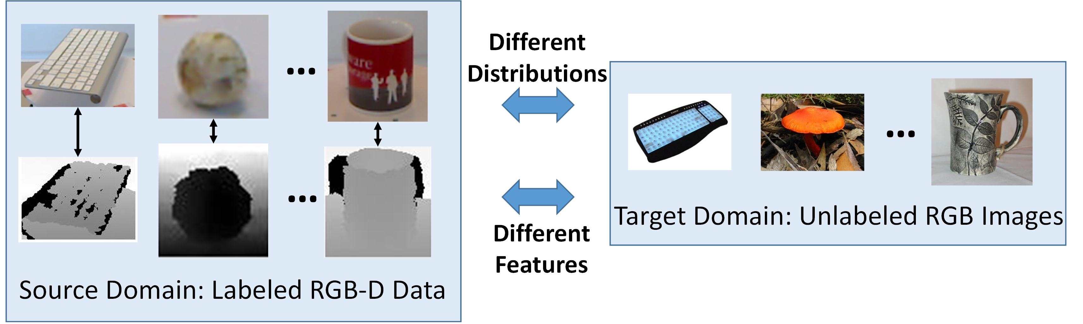
Q&A Backup
RGB-D Training, RGB-Only Deployment
Source: labeled RGB + paired depth
Target: unlabeled RGB
Two challenges: distribution shift and a missing test-time modality
Source image: Li et al., TPAMI 2018, Fig. 1
19
Notes:
Q&A BACKUP — SLIDE 19
Suggested answer time: 50 seconds
SPOKEN ANSWER
On the left, the source dataset contains RGB images, paired depth images and class labels. On the right, the target dataset contains RGB images only. The class vocabulary is shared, but the appearances and backgrounds differ. This gives us two problems at once: distribution shift, and a modality that disappears at test time.
We can use unlabeled target RGB examples during adaptation. We cannot use target depth, and the training objective does not use target labels. Depth therefore acts as additional training information. The aim is to transfer useful information into a recognizer that still works when its only input is RGB. The objective on slide 6 shows how DAM2S expresses these requirements.
PRESENTER CUE — NOT SPOKEN
Point left for RGB plus depth, then right for RGB only. Pause after 'two problems at once'. Distinguish the training objective from model selection, which is discussed on slide 13.
SHORT ANSWER
Source data has RGB, depth and labels. Target data has only RGB. DAM2S must handle both distribution shift and a missing modality.
Sources: https://wenli-vision.github.io/papers/Li_TPAMI2017_RGBD.pdf

Slide 20
Q&A Backup
Notation and Normalization
Combined normalization excludes joint collapse. It does not alone exclude P = 0.
Fixes source scatter in the RGB projection and excludes P = 0.
C has no A/B normalization constraint on P. It regularizes P toward T.
Li et al., §§3.1–3.3. Φ and Ψ contain feature vectors as columns.
20
Notes:
Q&A BACKUP — SLIDE 20
Use only when relevant during the discussion.
LIKELY QUESTION
Why does the learned projection not collapse to zero?
SPOKEN ANSWER — ABOUT 40–45 SECONDS
The answer depends on the variant. For B, the constraint fixes the projected source scatter to the identity, so a zero RGB projection is impossible. A instead normalizes the sum of the RGB and depth scatter terms. That excludes both projections being zero together, but it does not exclude a zero RGB projection by itself. The correlation term and source classification losses also guide the representation. C uses a different mechanism: its transformation is regularized toward the kernel alignment matrix T, without the same normalization constraint.
FOLLOW-UP ANSWER
If asked about singular scatter matrices: the reproduction adds ridge regularization for numerical stability. This is an implementation choice beyond the paper's displayed constraint.
PRESENTER CUE — NOT SPOKEN
Point to B first, then to the plus sign in A. Do not describe A as two separate whitening constraints. Allow about 40 seconds.
Sources: https://wenli-vision.github.io/papers/Li_TPAMI2017_RGBD.pdf
Equation source (LaTeX, for future editing):
\[ \Phi_s=[\phi(x_1^s),\ldots,\phi(x_{n_s}^s)],\qquad\Psi=[\psi(z_1),\ldots,\psi(z_{n_s})] \]
\[ \mathrm{A:}\quad P^{\top}\Phi_s\Phi_s^{\top}P+Q^{\top}\Psi\Psi^{\top}Q=I_m \]
\[ \mathrm{B:}\quad P^{\top}\Phi_s\Phi_s^{\top}P=I_m \]

Slide 21
Q&A Backup
Kernel Subspace Alignment and Prediction
C source training score
C target prediction score
Li et al., Eqs. (3)–(5), (14)–(16). Closed-form alignment derivation shown explicitly.
21
Notes:
Q&A BACKUP — SLIDE 21
Use only when relevant during the discussion.
LIKELY QUESTION
Where does the alignment matrix come from, and why is P absent at test time in C?
SPOKEN ANSWER — ABOUT 40–45 SECONDS
Kernel PCA gives orthonormal source and target bases. Differentiate the squared alignment error with respect to T and set the derivative to zero. Because S sub s transpose S sub s equals the identity, the solution is S sub s transpose S sub t. C then learns a discriminative transformation P near this initial alignment. During training, P transpose moves source coordinates toward target coordinates. A target example is already represented in the target basis, so its prediction uses S sub t transpose phi of x directly, without multiplying by P again.
FOLLOW-UP ANSWER
If asked why use P instead of the fixed T: the classification and depth-consistency terms can adjust the geometric alignment to better fit the supervised source task.
PRESENTER CUE — NOT SPOKEN
Trace the top derivative, then compare the source and target score lines. Emphasize that P acts on source coordinates. Allow about 45 seconds.
Sources: https://wenli-vision.github.io/papers/Li_TPAMI2017_RGBD.pdf
Equation source (LaTeX, for future editing):
\[ \min_T\;\Vert S_sT-S_t\Vert_F^2,\qquad S_s^{\top}S_s=I_m \]
\[ 2S_s^{\top}(S_sT-S_t)=0\quad\Longrightarrow\quad T=S_s^{\top}S_t=\widetilde{A}_s^{\top}K_{st}\widetilde{A}_t \]
\[ f_k^{v,s}(x)=w_k^{\top}P^{\top}S_s^{\top}\phi(x)+b_k \]
\[ f_k^{v,t}(x)=w_k^{\top}S_t^{\top}\phi(x)+b_k \]
Notation refinement: tilde A_s and tilde A_t are the kernel-PCA coefficient matrices, distinct from the all-sample expansion coefficients A on slide 23.

Slide 22
Q&A Backup
RGB-Only Inference for A and B
A: both classifier heads receive projected RGB
The depth-trained head transfers through the shared coordinate space.
B: use the RGB classifier head
No depth image or estimated depth feature is required at inference.
Li et al., §3.3.1–3.3.2. Final class prediction is argmax over k.
22
Notes:
Q&A BACKUP — SLIDE 22
Use only when relevant during the discussion.
LIKELY QUESTION
How can a model trained with depth make a prediction from RGB alone?
SPOKEN ANSWER — ABOUT 40–45 SECONDS
Depth influences training, but the prediction rules do not require a depth input. In A, RGB and depth features are projected into a shared coordinate space. At test time, both classifier heads receive the same projected RGB vector, and their scores are averaged. B predicts with the RGB head alone. C also uses only its RGB head, evaluated in target-subspace coordinates. So the transferred knowledge is stored in the learned representation and classifier parameters. The method does not reconstruct a depth image at test time.
FOLLOW-UP ANSWER
If asked whether this is knowledge distillation: B and C jointly train two SVM heads with a consistency penalty. There is no fixed teacher network, so prediction agreement is the more precise description.
PRESENTER CUE — NOT SPOKEN
For A, point to the sum of the two weight vectors. For B, point to the single RGB score. Allow about 40 seconds.
Sources: https://wenli-vision.github.io/papers/Li_TPAMI2017_RGBD.pdf
Equation source (LaTeX, for future editing):
\[ f_k^{(A)}(x)=\frac{1}{2}\left[(w_k+\widetilde{w}_k)^{\top}P^{\top}\phi(x)+b_k+\widetilde{b}_k\right] \]
\[ f_k^{(B)}(x)=w_k^{\top}P^{\top}\phi(x)+b_k \]

Slide 23
Q&A Backup
Computing the MMD Penalty with Kernels
Only Gram matrices are needed. The RKHS dimension can be infinite.
Implementation detail: the supplied code restricts the projection to the source span.
Algebraic derivation from Li et al., Eq. (2). General all-sample-span parameterization.
23
Notes:
Q&A BACKUP — SLIDE 23
Use only when relevant during the discussion.
LIKELY QUESTION
How is this computable if the kernel feature space is infinite-dimensional?
SPOKEN ANSWER — ABOUT 40–45 SECONDS
The kernel trick replaces feature-space inner products with entries of a finite Gram matrix. Here, e gives equal positive weights to source samples and equal negative weights to target samples, so Phi times e is the difference between their empirical means. Write the projection as Phi times A, then substitute this into the MMD trace expression. Every Phi transpose Phi becomes K. The final expression uses only finite matrices. This slide uses the general all-sample span; our implementation restricts the projection to the source span.
FOLLOW-UP ANSWER
If asked whether zero projected MMD proves identical distributions: no. The learned finite projection may discard information, so a characteristic original kernel does not make projected mean matching a guarantee of equality or target accuracy.
PRESENTER CUE — NOT SPOKEN
Explain e before the substitution. Identify the repeated Phi transpose Phi products rather than reading every matrix letter. Allow about 40 seconds.
Sources: https://wenli-vision.github.io/papers/Li_TPAMI2017_RGBD.pdf
Equation source (LaTeX, for future editing):
\[ \Phi=[\Phi_s,\Phi_t],\qquad e=\left[\frac{1}{n_s}\mathbf{1}_{n_s}^{\top},\;-\frac{1}{n_t}\mathbf{1}_{n_t}^{\top}\right]^{\top} \]
\[ \delta=\Phi e,\qquad K=\Phi^{\top}\Phi,\qquad P=\Phi A \]
\[ \Omega_{\mathrm{MMD}}(P)=\frac{1}{2}\operatorname{tr}(P^{\top}\Phi ee^{\top}\Phi^{\top}P)=\frac{1}{2}\operatorname{tr}(A^{\top}Kee^{\top}KA) \]

Slide 24
Q&A Backup
Protocol Differences That Affect Comparability
Choice | Paper | Reproduction
RGB features | Caffe DeCAF6 | Torchvision AlexNet fc6 + ReLU
Depth weight λ | A 0.01, B 1, C 10 | Search 0.0001 to 1
Source sampling | 2,059 training images reported | Uniform quota of 2,059 images
Model selection | No verified oracle claim | Best target-label score
A no-depth plot | No corresponding ablation | Code substitutes B without depth
Unequal search budgets can create unequal selection bias.
Sources: Li et al., §4.2; handoff, pp. 6–7; run_or.py and make_figures.py
24
Notes:
Q&A BACKUP — SLIDE 24
Use only when relevant during the discussion.
LIKELY QUESTION
Is this a faithful reproduction, and is the evaluation truly unsupervised?
SPOKEN ANSWER — ABOUT 40–45 SECONDS
We describe it as a partial reproduction because several choices differ. The RGB feature implementation and source sampling changed. The original paper fixes C's depth weight at ten, while the reproduction searches a grid ending at one. Training uses unlabeled target features, but the reproduction selects hyperparameters using target labels. Those tuned results are therefore target-oracle results, not an unbiased deployment estimate. We verified that selection rule in our code, but not the handoff's claim that the paper used the same rule. These differences limit direct comparability.
FOLLOW-UP ANSWER
If asked about the omitted A ablation: the plotting script substitutes B without depth for A's no-depth comparison. It changes the variant, so we exclude it from the depth-ablation evidence.
PRESENTER CUE — NOT SPOKEN
Answer the evaluation question directly, then point to the lambda row. Avoid claiming that equal access to target labels makes unequal searches fully fair. Allow about 45 seconds.
Sources: https://wenli-vision.github.io/papers/Li_TPAMI2017_RGBD.pdf; /Users/weidai/Desktop/COMP9501/DAM2S论文复现_转交文档.pdf; supplied code/run_or.py; code/make_figures.py

Slide 25
Q&A Backup
Training Times Across Two Different Tasks
Experiment | A | B | C
Paper: CD-HAR | 20.7 s | 168.4 s | 398.2 s
Reproduction: object recognition | 19.2 s | 16.5 s | 3.6 s
The runtime ordering reverses in the supplied implementation.
Task, hardware, solver and iteration counts differ.
The reproduction timer excludes shared feature and kernel preparation.
Paper Table 3 uses CD-HAR. Reproduction handoff uses object recognition, 3-run means.
25
Notes:
Q&A BACKUP — SLIDE 25
Use only when relevant during the discussion.
LIKELY QUESTION
Why is C fastest in the reproduction but slowest in the paper?
SPOKEN ANSWER — ABOUT 40–45 SECONDS
The timings come from different experiments, so we cannot interpret the difference as a speedup. The paper measures cross-dataset human action recognition, while our reproduction measures object recognition. The implementations, hardware, dimensions and iteration counts also differ. The reproduced numbers are means of three runs on an idle machine. Its timer excludes shared feature and kernel preparation, although it includes C-specific subspace alignment. The reliable statement is that the runtime ordering reverses in this implementation. An algorithmic efficiency comparison would require a matched task, environment and timing boundary.
FOLLOW-UP ANSWER
If asked what should be timed in a fair comparison: use the same inputs and hardware, report common preprocessing separately, and compare the same training stages with identical stopping rules.
PRESENTER CUE — NOT SPOKEN
Read the experiment labels before any numbers. Do not divide the two C timings and call the ratio a speedup. Allow about 40 seconds.
Sources: https://wenli-vision.github.io/papers/Li_TPAMI2017_RGBD.pdf Table 3; /Users/weidai/Desktop/COMP9501/DAM2S论文复现_转交文档.pdf p. 5; code/time_dam2s.py

Slide 26
Q&A Backup
Questions About Validity
Does a small MMD guarantee target accuracy?
No. Projected marginal means can align while classes remain mismatched.
Is a 0.3-point lead over DIP statistically reliable?
The materials provide no independent-split uncertainty analysis.
Does objective descent prove the best solution?
No. Candidate acceptance gives numerical descent, without a global-optimum guarantee.
Answers apply to the inspected paper and the supplied reproduction materials.
26
Notes:
Q&A BACKUP — SLIDE 26
Use only when relevant during the discussion.
LIKELY QUESTION
What guarantees do the alignment, optimization and results actually provide?
SPOKEN ANSWER — ABOUT 40–45 SECONDS
There are three separate limits. A small projected MMD means that projected domain means are close; it does not prove that corresponding classes align. A decreasing objective shows numerical progress, but the joint problem is nonconvex and the implementation accepts improving candidates, so descent does not certify a global optimum. Finally, the zero-point-three percentage-point lead over DIP is descriptive. We have no independent-split uncertainty analysis establishing that the lead is statistically reliable. These results support a qualitative reproduction of the ordering, with caution about the size and reliability of the gains.
FOLLOW-UP ANSWER
If asked for the next experiment: freeze the preprocessing and label-blind selection rule, then compare paired method differences across independent data splits and report uncertainty for mean per-class accuracy.
PRESENTER CUE — NOT SPOKEN
Usually answer only the part the examiner asks. Use the full answer only if asked for an overall validity assessment. Allow up to 45 seconds.
Sources: https://wenli-vision.github.io/papers/Li_TPAMI2017_RGBD.pdf

Slide 27
References
References and Evidence
Li, W., Chen, L., Xu, D., and Van Gool, L. (2018)
Visual Recognition in RGB Images and Videos by Learning from RGB-D Data.
IEEE Transactions on Pattern Analysis and Machine Intelligence, 40(8), 2030–2036.
doi.org/10.1109/TPAMI.2017.2734890
Reproduction evidence
DAM2S reproduction handoff, 30 October 2026, 9 pages
Supplied Python code: objectives, evaluation, plotting and timing
Numeric reproduction values are reported results, not newly rerun experiments.
Primary paper, reproduction handoff and supplied implementation
27
Notes:
Q&A BACKUP — SLIDE 27
Use only when relevant during the discussion.
LIKELY QUESTION
Which parts of the presentation come from the paper and which come from the reproduction?
SPOKEN ANSWER — ABOUT 40–45 SECONDS
The original problem figure, the DAM2S formulations and the published benchmark values come from Li and colleagues' TPAMI paper, checked against the author-hosted manuscript. The reproduced accuracies, ablation gains and timings come from our team's handoff document. The supplied code lets us inspect the objectives, model-selection rule and plotting logic. The package available for this presentation contains code but no raw result files, so we report only explicitly documented reproduction values. The MMD trace expansion and alignment differentiation are explanatory derivations of the paper's equations.
FOLLOW-UP ANSWER
If asked whether all experiments were repeated while preparing these slides: no. The talk reports the team's supplied reproduction results. The preparation checked the paper, code and documented values rather than rerunning the experiments.
PRESENTER CUE — NOT SPOKEN
Use this page for source clarification. Distinguish the team's experiments from the later presentation audit. Allow about 40 seconds.
Sources: https://wenli-vision.github.io/papers/Li_TPAMI2017_RGBD.pdf; /Users/weidai/Desktop/COMP9501/DAM2S论文复现_转交文档.pdf

Slide 28
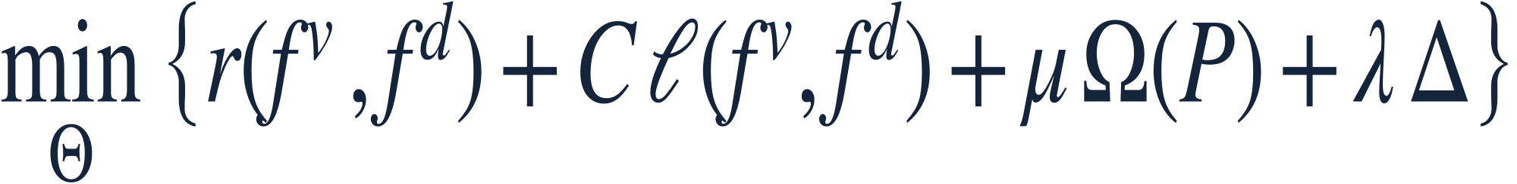
Q&A Backup
训练数据与总目标
模型能看到哪些数据
源域的每个样本都有 RGB 输入 x、深度 z 和标签 y。目标域只提供 RGB。判断样本是否属于第 k 类时，标签取 +1 或 −1。
四项一起最小化
r 控制两套分类器的复杂度，ℓ 衡量源样本的分类损失。Ω 对齐两域的 RGB 分布，Δ 用配对的深度信息指导 RGB 学习。
C、μ、λ 依次控制分类损失、域对齐和深度信息在训练中的权重。
Li et al. (2018)，式 (1) · 正文第 6 页
28
Notes:
中文公式导读 · 第 28 页
训练数据与总目标
源域样本是配对的 RGB 和深度，且有类别标签。目标域的 RGB 参与无监督适应。Θ 表示当前变体需要学习的参数。总目标的各项分别控制模型复杂度、源域标签拟合、域对齐和跨模态学习。公式中的 C 是权重，与变体 C 的名称含义不同。

Slide 29
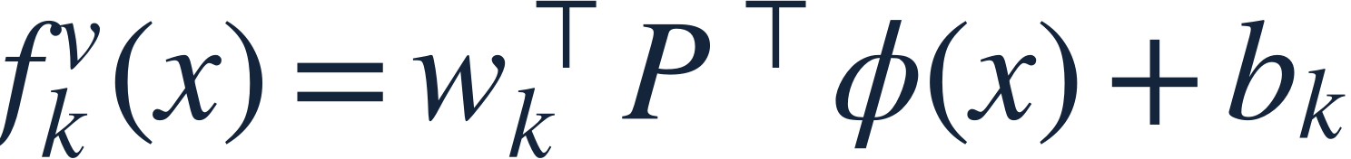
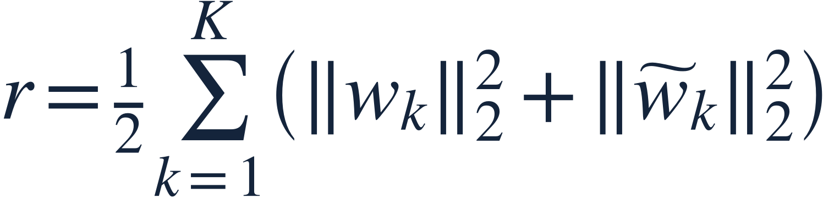
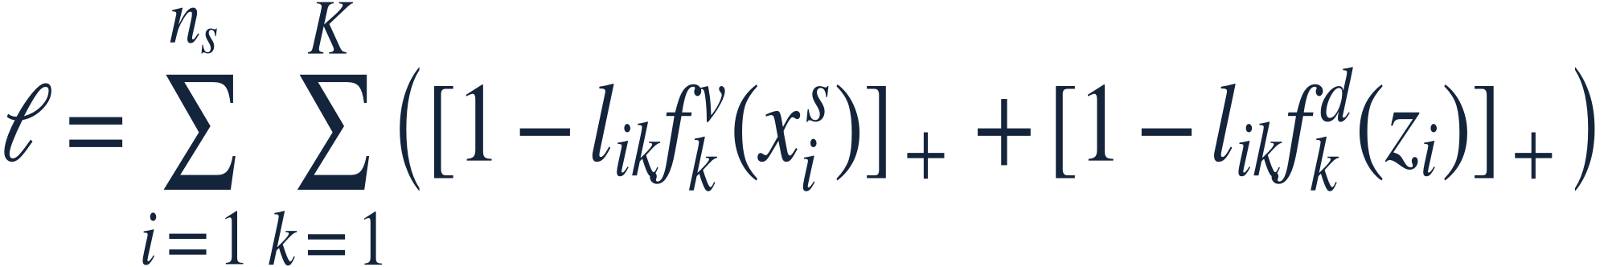
Q&A Backup
两套 SVM 如何学习源域类别
A、B 的 RGB 分类得分
φ 把 RGB 输入映射到核特征空间，P 再把它投影到低维空间。第 k 个分类器在这个空间给出得分。
控制分类器复杂度
每个类别都有一组 RGB 权重和一组深度权重。两组权重的范数越大，这一项的惩罚越重。
两种模态的合页损失
用同一源标签分别检查两路预测。标签与得分的乘积达到 1，该路损失为零；低于 1，就按差额计入损失。
方括号右下角的 + 表示取正部，即只保留大于零的部分。
Li et al. (2018)，式 (7)–(13) · 正文第 7 页
29
Notes:
中文公式导读 · 第 29 页
两套 SVM 如何学习源域类别
源标签采用一对其余类别的编码。对一个类别，正样本希望得分至少为 +1，负样本希望得分至多为 −1。RGB 与深度共用标签，但各自计算损失；总目标中的范数正则配合合页损失得到间隔分类器。

Slide 30
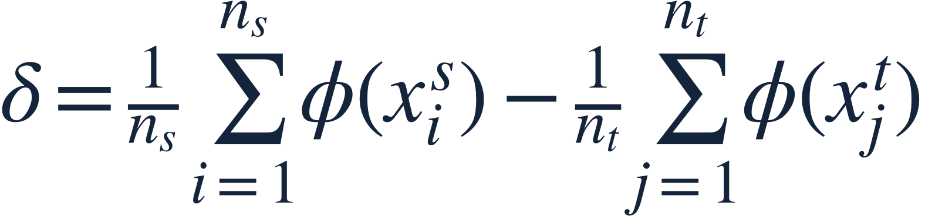

Q&A Backup
A、B 如何对齐两域的 RGB 均值
两域的均值相差多少
先将两域的 RGB 样本映射到同一个核特征空间，再分别求均值。δ 是源域均值减去目标域均值。
投影后的均值差
Pᵀδ 是两个均值经过投影后的差。最小化其平方长度会拉近整体均值，但各类别仍可能错位。
限制投影的尺度
A 联合约束 RGB 投影 P 和深度投影 Q，两者不能同时为零。B 只约束 P，因此直接排除了 P = 0。
Li et al. (2018)，式 (2) 及 A、B 的归一化约束 · 正文第 8 页，备份第 20、23 页
30
Notes:
中文公式导读 · 第 30 页
A、B 如何对齐两域的 RGB 均值
Φₛ 和 Ψ 分别把源域的 RGB 和深度核特征按列堆放。A 的单位阵约束作用在两项之和，并不单独排除 P 为零。B 则直接规定投影后的源域 RGB 散布矩阵为单位阵。正文第 8 页还给出了 MMD 项对 P 的梯度，备份第 23 页给出了核化展开。

Slide 31

Q&A Backup
C 如何对齐源域与目标域的 RGB 子空间
先求参考变换 T
Sₛ 和 Sₜ 分别是源域和目标域的核 PCA 基。选择 T，使变换后的源基尽量接近目标基。正交性给出闭式解。
让可学习的 P 靠近 T
P 是两个低维坐标系之间的变换。它可以随分类目标调整；偏离初始对齐 T 越远，惩罚越大。
训练时怎样使用 P
先用源基求出源样本的坐标，再用 Pᵀ 将坐标对齐到目标坐标系，最后计算第 k 类的得分。
Li et al. (2018)，式 (3)–(5)、(14)–(16) · 正文第 10 页，备份第 21 页
31
Notes:
中文公式导读 · 第 31 页
C 如何对齐源域与目标域的 RGB 子空间
这里 P 是 m × m 的矩阵，作用在子空间坐标上；A、B 的 P 则是从 RGB 核特征空间到低维空间的投影。Sₛ 与 Sₜ 分别由两域的核 PCA 得到。测试样本来自目标域，直接使用目标基即可，见第 33 页。

Slide 32
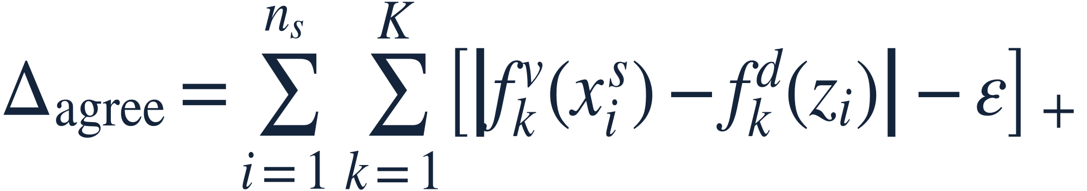
Q&A Backup
源域深度怎样指导 RGB 学习
A 让配对特征更相关
P 投影 RGB 特征，Q 投影深度特征。迹汇总同一样本两种投影的内积。前面取负号，使最小化这一项会提高配对特征的相关性。
B、C 让分类得分更接近
对同一源样本和同一类别，比较 RGB 与深度分类器的得分。差距在容差 ε 内就不罚，只惩罚超出的部分。
论文取 ε = 0.001。这里省略了与模型参数无关的常数，最优解相同。
Li et al. (2018)，式 (6)、(10) · 正文第 9 页
32
Notes:
中文公式导读 · 第 32 页
源域深度怎样指导 RGB 学习
A 通过共享低维空间让配对 RGB 与深度特征彼此关联。B、C 使用两个联合训练的分类器并约束同一样本的得分。论文式 (10) 写成 max(ε, |差值|)，减去每一项中的常数 ε 即得到本页的正部写法。

Slide 33
Q&A Backup
测试时怎样只用 RGB 预测
A 平均两个分类器的得分
先把测试 RGB 投影到共享空间，再把同一个向量交给两个分类器。即使第二个分类器学自深度，它在测试时也接收 RGB 投影。
B 只用 RGB 分类器
深度分类器在训练时约束 RGB 分类器的得分。预测时，直接用 RGB 投影和 RGB 分类器即可。
C 直接使用目标域坐标
测试 RGB 已经来自目标域，用目标基 Sₜ 计算坐标后即可分类。Pᵀ 只用于变换源域坐标。
三种变体都为每个类别 k 计算一个得分，取分数最高的类别作为预测。
Li et al. (2018)，第 3.3 节 · 备份第 21–22 页
33
Notes:
中文公式导读 · 第 33 页
测试时怎样只用 RGB 预测
A 平均的是两个头各自的得分，而不是先预测深度图。B 只保留 RGB 分类头。C 的源样本需要跨坐标系变换，目标样本天然位于目标域，直接使用目标基。最终对所有类别取 argmax。

